Slide 1
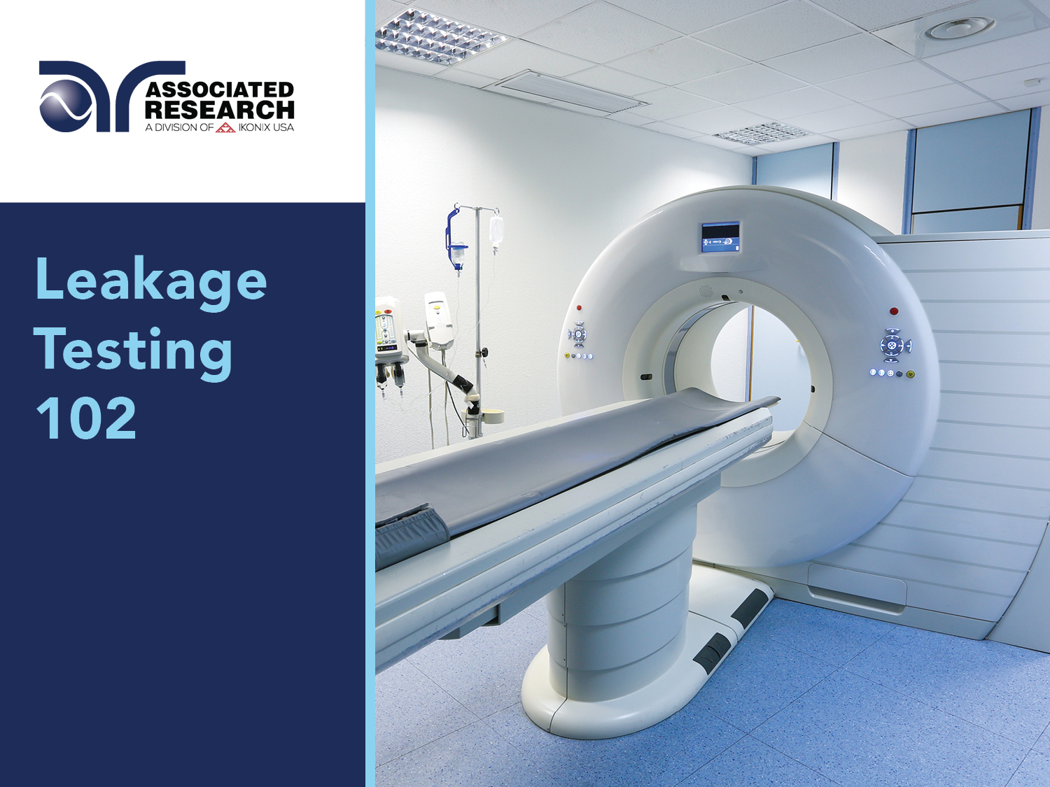

Slide 2


Slide 3
Webinar Notes
Please use the Q & A utility to ask us any questions concerning
the material being presented.
Please contact Brittany Socha - chat line or email brittany.socha@arisafety.com if you would like a copy of the presentation.

Slide 4
Touch Current Testing 102 – Learning Objectives
Leakage Current
Description
IEC 60601-1
IEC 60601-1 3rd Edition and the leakage current tests
Testing Examples
IEC 60601-1 discussion and reference diagrams
Network and MD
Tests called out for in the standard
Leakage testing video examples
Leakage Current Types
Touch Current
Patient Leakage
Patient Auxiliary Leakage
Mains on Applied Part Leakage

Slide 5
Leakage Current Types
Touch Current
Electric current through a human body when it touches one or more accessible parts of an installation or surface of electrical equipment¹
Patient Leakage Current
Current flowing from the patient connections via the patient to earth
Also called Enclosure Leakage Current.
Patient Auxiliary Current
Mains on Applied Part
Current originating from the unintended appearance of a voltage from an external source on the patient and flowing from the patient via the patient connections of an F-Type applied part to earth.
Current flowing in the patient in normal use between any patient connection and all other patient connections (and not intended to produce a physiological effect^{)2.}
Application of mains voltage on an applied part or patient lead.
1 – IEC 60990 2nd edition: Methods of Measurement of Touch Current and Protective Conductor Current
2 – IEC 60601-1 3rd edition: Medical Electrical Equipment

Slide 6
Patient Lead Types
Patient Leads
F-Type: APPLIED PART in which the PATIENT CONNECTIONS are isolated from other parts of the ME EQUIPMENT
Type BF: F-TYPE APPLIED PART provide a higher degree of protection against electric shock than that provided by TYPE B APPLIED PARTS
Type CF: F-TYPE APPLIED PART provide a highest degree of protection against electric shock than that provided by TYPE BF APPLIED PARTS
B Type: APPLIED PART that provides protection against electric shock
IEC 60601-1 3rd edition: Medical Electrical Equipment
Notes:
F-type Applied part which is electrically isolated from Earth and other parts of the medical equipment. IE floating F-type applied part are eithr BF or CF applied part
Type BF applied part – F type with higher degree of portection against electric shock than type B appiled parts – not suitable for cardiac applicatoins
Type CF applied part – highest degree of portection against electrick shock – suitable for direct cardiac application
B-type
Applied part are those parts, which are usally earth referenced
Not suitable for direct cardiac applications

Slide 7
How Is It Measured?
MD
Leakage current is measured through a human body impedance network, also known as a Measuring Device (MD)
Body Impedance
MD is designed to simulate the impedance of the human body under various conditions.
Normal and Single Fault Conditions
Measurements taken under normal conditions.
Measurements also taken under single fault conditions to simulate worst case scenarios
THE MAIN QUESTION TO ASK What is the severity of electric current someone would be exposed to if they were to touch the DUT under such conditions?

Slide 8
How Is It Measured?
Medical Devices
IT Equipment
Electric Spas
MD will vary by product standard. Most MDs are derived from IEC 60990-1

Slide 9
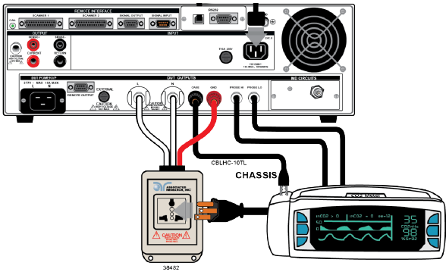

Slide 10
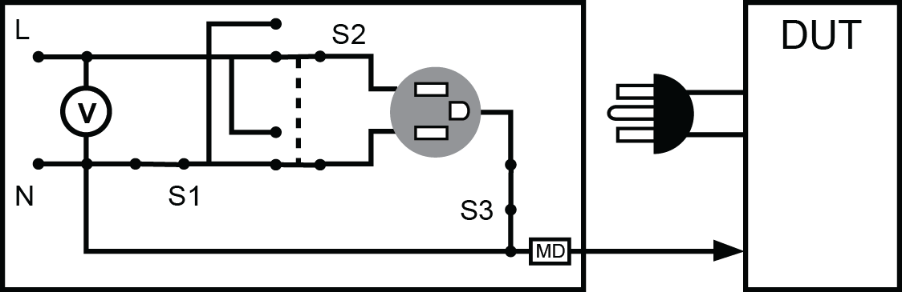

Slide 11
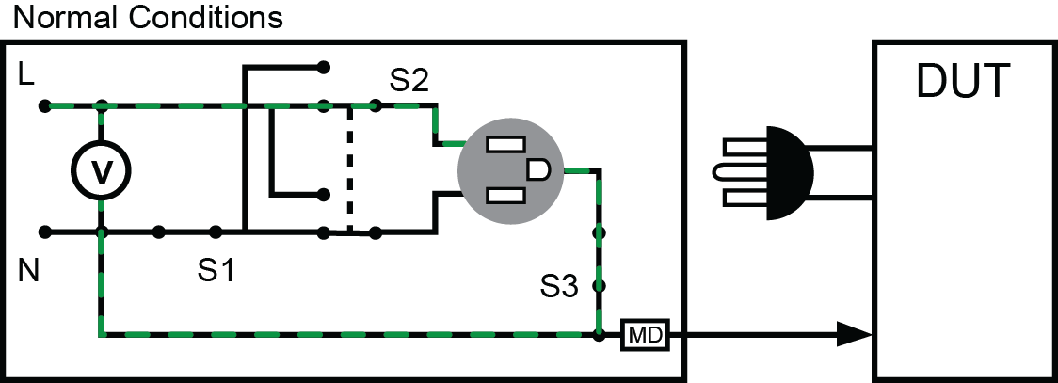

Slide 12
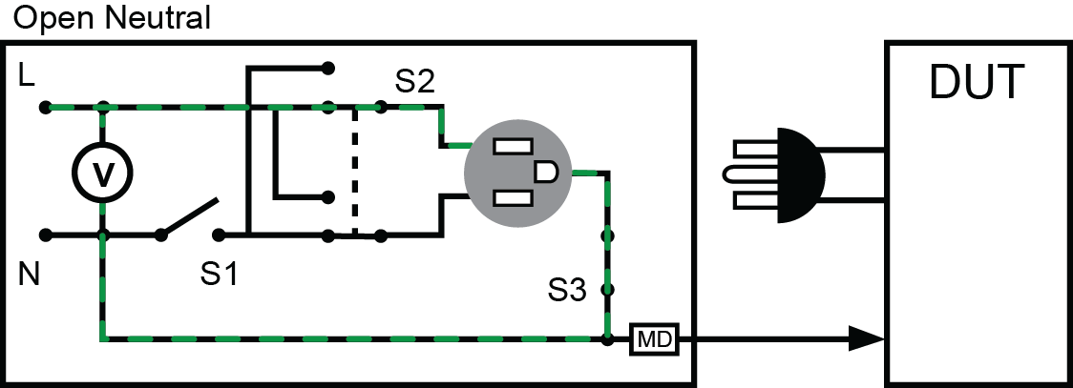

Slide 13
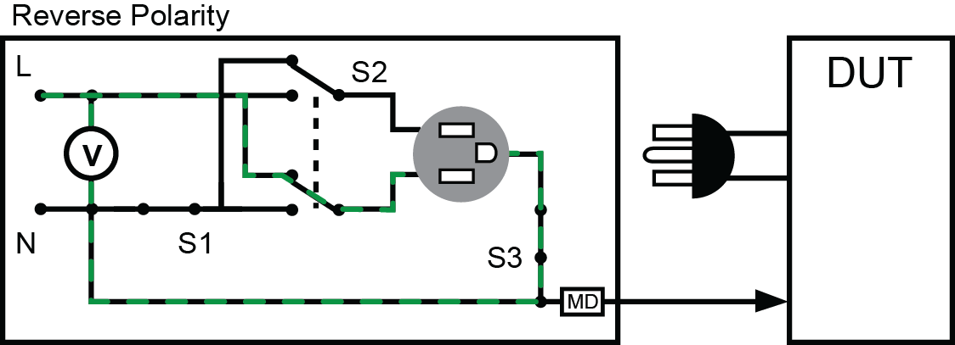

Slide 14
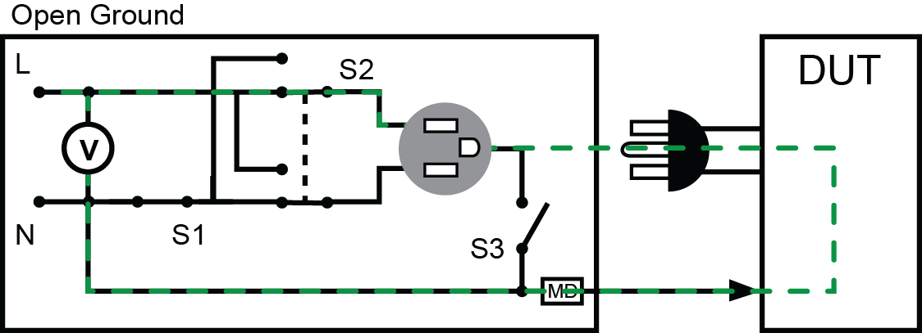

Slide 15
POLL QUESTION

Slide 16
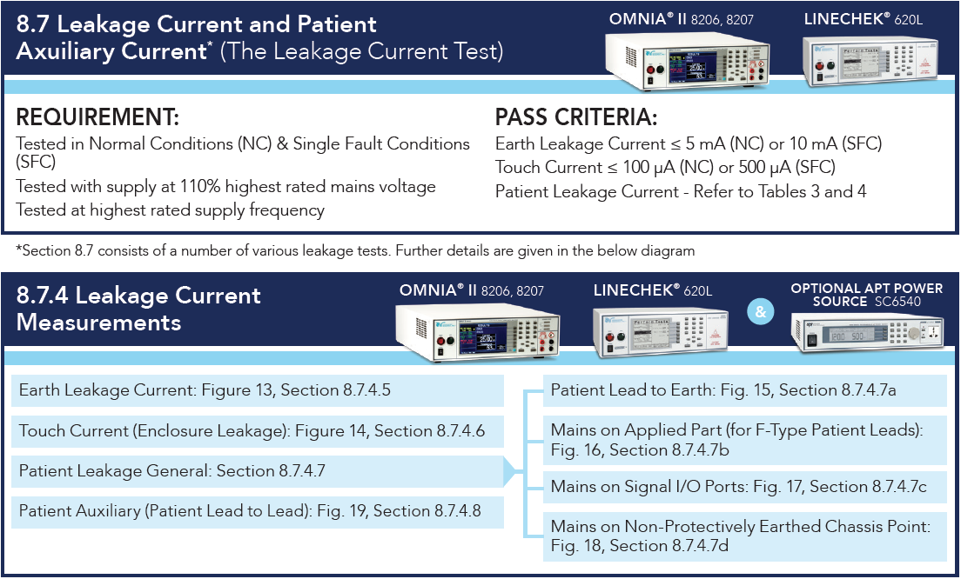
IEC 60601-1 Medical Equipment

Slide 17
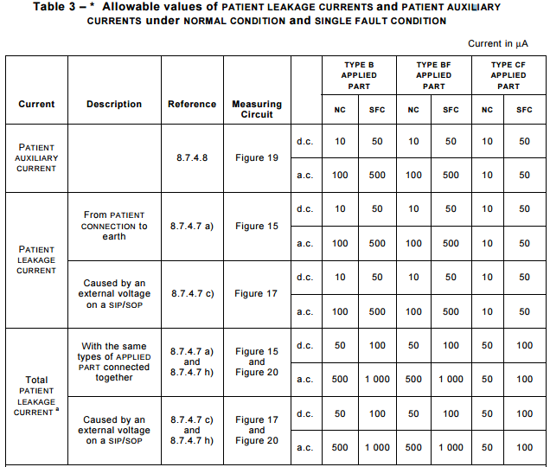
Patient Leakage Current

Slide 18
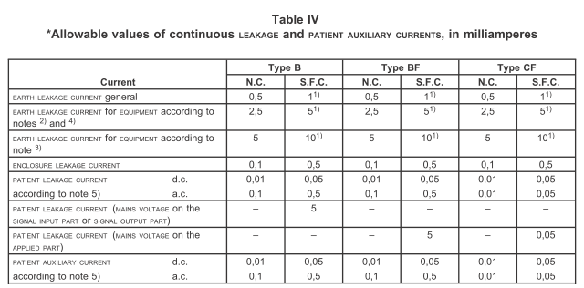
Patient Leakage Current

Slide 19
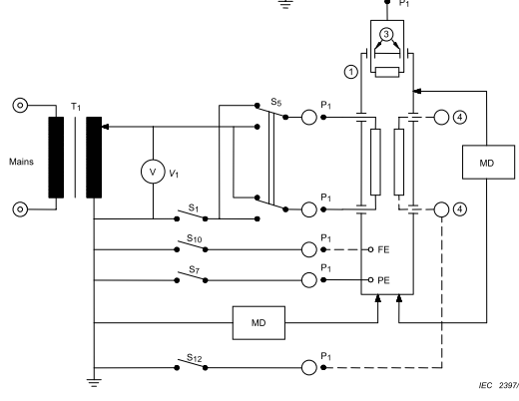
Touch Current
60601-1 – Figure 14

Slide 20
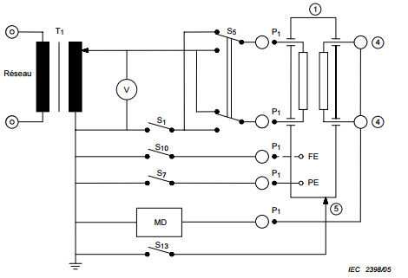
Touch Current
60601-1 – Figure 15

Slide 21

Touch Current

Slide 22
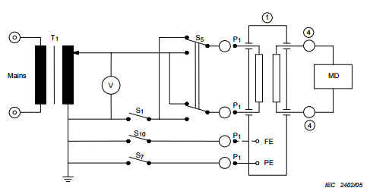
Patient Auxiliary Current
60601-1 – Figure 19

Slide 23
Patient Auxiliary Current

Slide 24
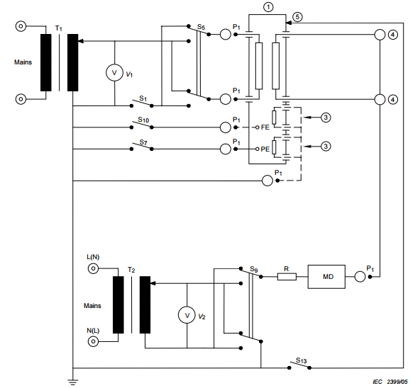
Mains on Applied Part
60601-1 – Figure 16

Slide 25
Mains on Applied Parts
https://www.youtube.com/watch?v=RQcMD-5Vw3c..\Desktop\Line Leakage Testing Demonstration.mp4

Slide 26
POLL QUESTION

Slide 27
Additional Tests and Considerations
Leakage current
Mains Voltage on Applied Part Figure 16
External voltage on SIO Figure 17
External voltage on metal accessible part that is not PE Figure 18

Slide 28

Contact Us
If you would like a copy of this presentation please email Brittany Socha at brittany.socha@arisafety.com
Check out our website for more information arisafety.com

Slide 29
JOIN US FOR OUR NEXT WEBINAR
Wednesday, November 15 10AM CT (GMT – 6:00) Automate Your Production Line: 6 Ways to Fully Automate Electrical Safety Testing
Click the link in chat box to learn more

